Slide 1
Lending Club Case Study

Slide 2
Business Objective
To identify variables which are strong indicators of default and potentially use the insights in approval / rejection decision making for lending club
Approach:
Provide a Data Intake Report, Count of Records, and Assumed Schema (it’s okay to take an estimated guess).
Create an EDA Report showing basic correlations and distributions of data and possible feature engineering suggestions.
Create a modeling report showing a Model Accuracy predicting is_bad as AUC or ROC Curve of at least 2 different model flavors.
Create a final Slide readout of results to be presented to a semi-technical business audience.

Slide 3
Data Understanding
Types of variables
Customer (applicant) demographic
Loan related information & characteristics
Customer behavior (if the loan is granted)
Overall Default Rate is 13%
Customer’s Demographic
Employee Length
Employee Title
Annual Income
Zip Code
Loan Related Information
Loan Amount
Home Ownership
Payment Plan
Verification Status
Customer Behavior
Delinquency Year - 2
Earliest Credit Line
Revolving Balance
Loan Purpose

Slide 4
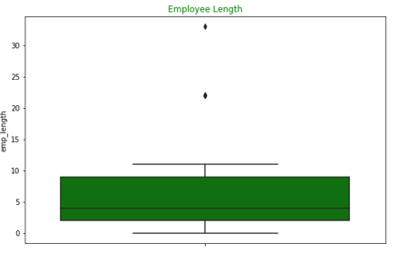
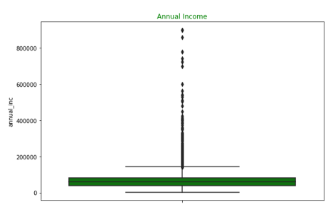
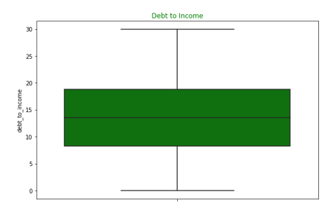
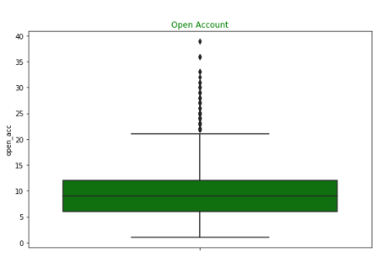
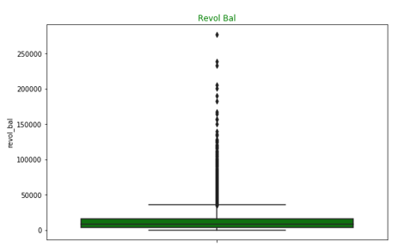
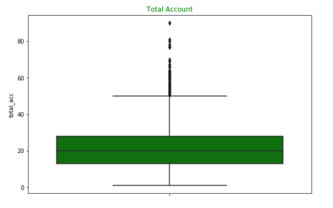
Exploratory Data Analysis – Univariate Analysis
Annual Income and Revolving Balance contains outliers.

Slide 5
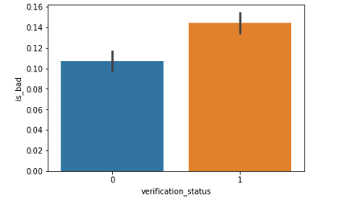
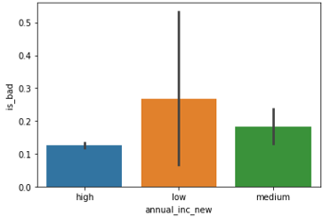
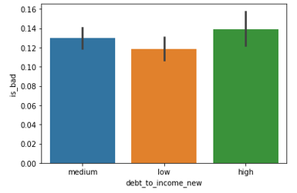
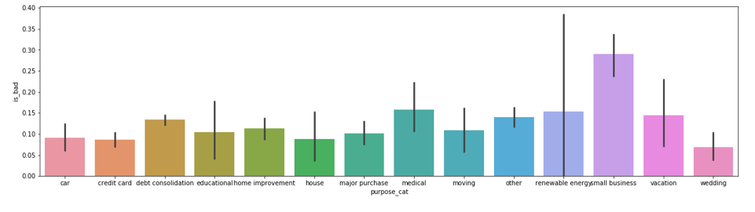
Exploratory Data Analysis – Bivariate Analysis
Verified Customers has defaulted more
Small business loans default the most, then medical
lower the annual income, higher the default rate
High dti translates into higher default rates, as expected

Slide 6
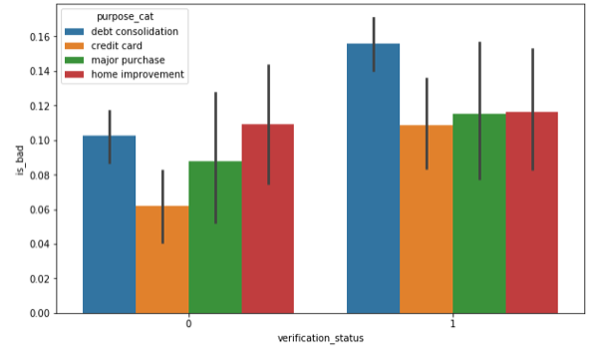
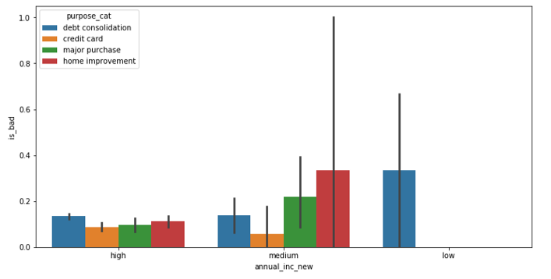
Exploratory Data Analysis – Segmented Bivariate Analysis
Debt Consolidation products for verified customers has defaulted more whereas Home improvement products for Non Verified customers has defaulted more
Debt consolidation products in low income customers has defaulted more

Slide 7
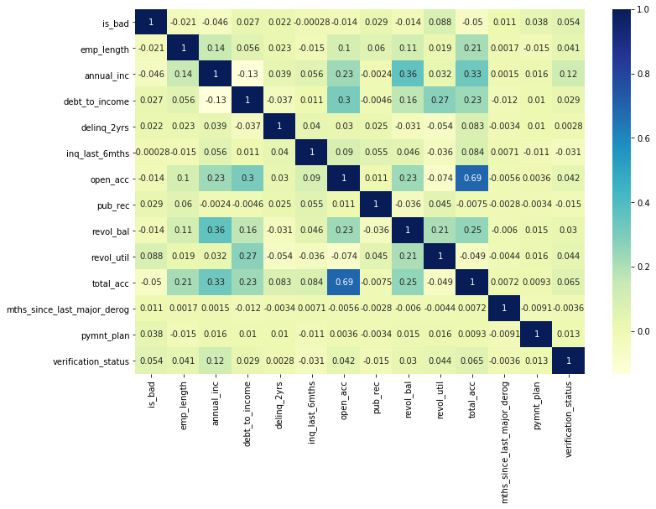
Correlation Matrix
Open Account and total account is highly correlated with 0.69% so created new feature(Open Account%)
revol_bal is highly correlated with is_bad with 0.088 %

Slide 8
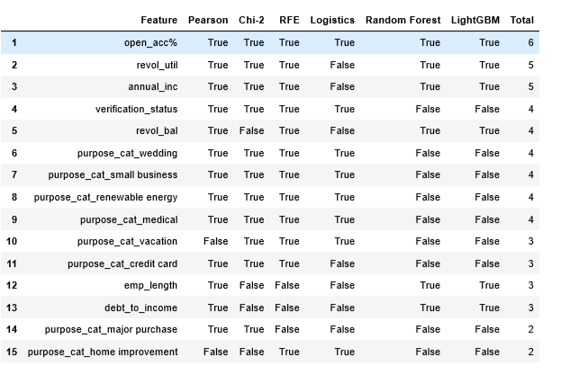
Feature Selection
Used 6 feature selection algorithms instead of relying only on one algorithm and choose those features which are present in at least 4 algorithms

Slide 9
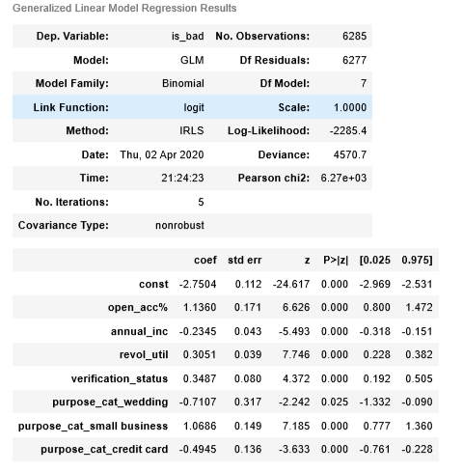
Top Features
Uses P-value to check the corelation and remove the correlated variables one by one
Uses VIF to check the multi-collinearity in the data set

Slide 10
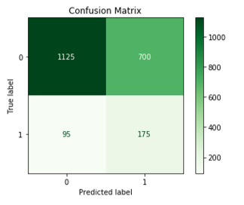
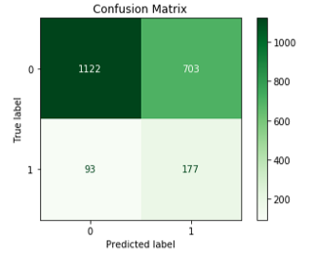
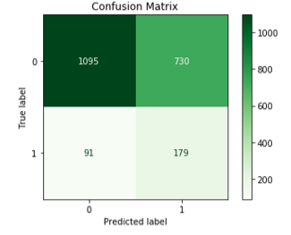
Confusion Matrix Comparison for Test Data
Logistic Regression
Random Forest
Support Vector Machine
Metrics | Logistic Regression | Random Forest | SVM
Sensitivity/Recall | 64.81 % | 65.56 % | 66.30 %
Specifity | 61.64 % | 61.48 % | 60.00 %
False Postive Rate | 38.36 % | 38.52 % | 40.00 %
Precision | 20.00 % | 20.11 % | 19.69 %
ROC AUC | 0.67 % | 0.65 % | 0.66 %

Slide 11
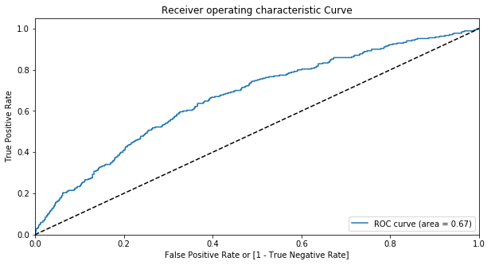
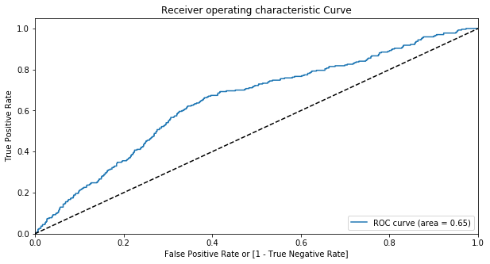
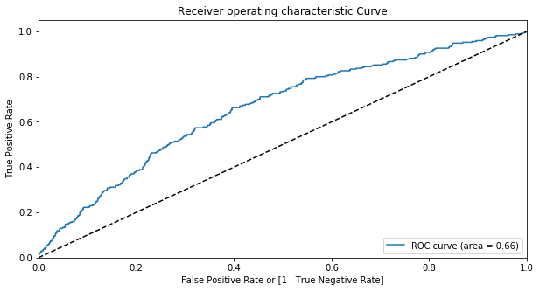
ROC Curve Comparison for Test Data
Logistic Regression
Random Forest
Support Vector Machine

Slide 12
Conclusion
Overall Default Rate is 13%
After Data cleaning Step, 94% records has been left for modelling
Univariate EDA shows presence of outliers in annual income and revolving balance
Bivariate EDA shows verified customers has defaulted more
Bivariate EDA shows Small business loans default the most, then medical
Bivariate EDA shows lower the annual income, higher the default rate
Bivariate EDA shows High dti translates into higher default rates as expected
Logistic Regression has better performance over Random Forest and SVM with a ROC AUC of 0.67 on test set.

Slide 13
Thank you

